Slide 1


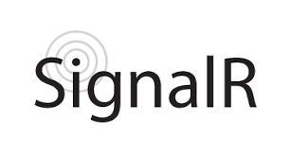

ASP.NET Core Cookbook
WebSockets, SignalR, Session & Cache
C# MVC Frameworks
SoftUni Team
Technical Trainers
Software University
http://softuni.bg

Slide 2
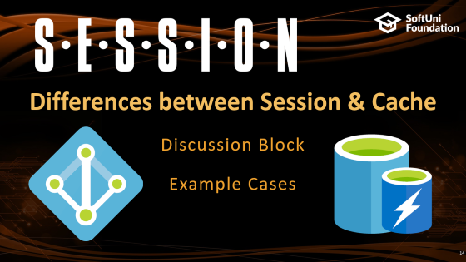

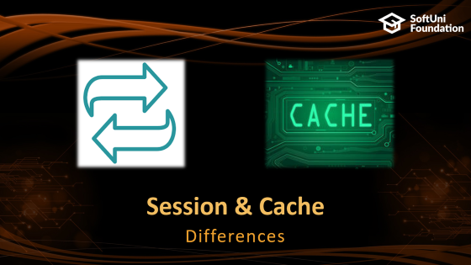
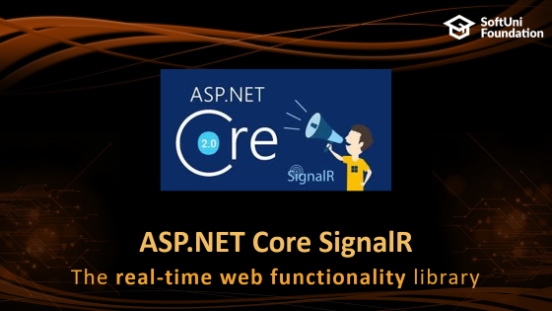
Table of Contents

Slide 3
Questions
sli.do #csharp-web

Slide 4

WebSockets
The art of FDx Communication

Slide 5

WebSockets
WebSocket is a communication protocol
Provides Full-Duplex communication
Channels over a single TCP connection
Faciliates real-time data transfer from and to the server
Secure and Optimized
Supported in all modern web browsers
Regarded as evolutionary for the client/server web development

Slide 6
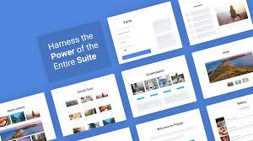
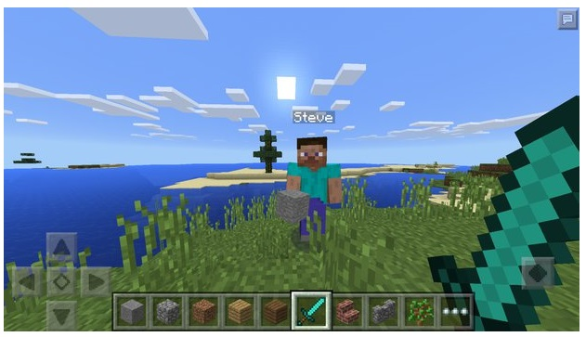



WebSockets
WebSockets proves to be the best decision in many cases:
Social feeds
Multiplayer games
Collaborative editing / coding
Clickstream data
Sports updates
Multimedia chat
Financial tickers

Slide 7
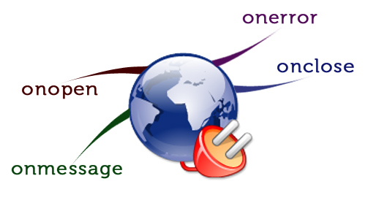
WebSockets in ASP.NET Core
Live Demo

Slide 8
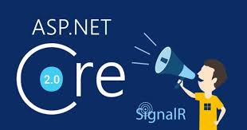
ASP.NET Core SignalR
The real-time web functionality library

Slide 9
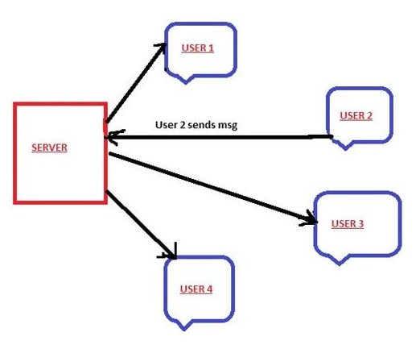

SignalR
SignalR is a library for ASP.NET Core
Is currently in Alpha
Makes the addition of real-time web functionality simple
Has a Client written fully on TypeScript

Slide 10
ASP.NET Core SignalR
public void ConfigureServices (IServiceCollection services)
{
services.AddSignalR();
}
public void Configure (IApplicationBuilder app)
{
app.UseSignalR(...);
}
Live Demo

Slide 11

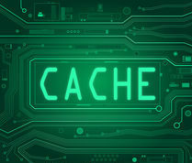
Session & Cache
Differences

Slide 12

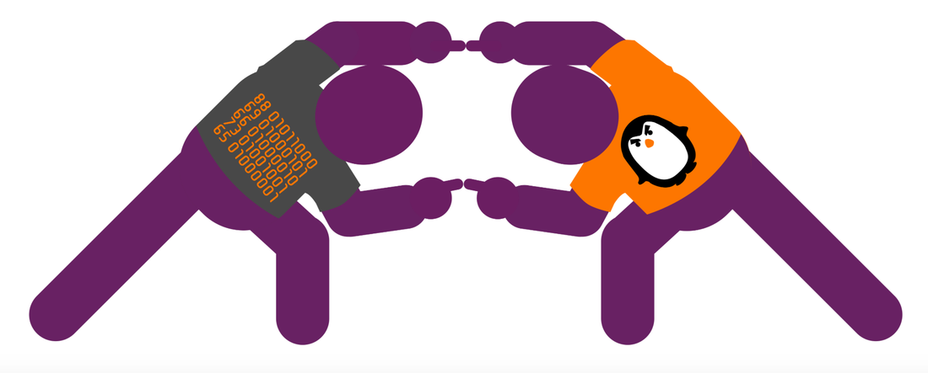

Session & Cache
Session is a feature that you can use to save and store user data
Can be accessed by all web pages
Should NOT contain any sensitive data
Will not be needed on the next login

Slide 13
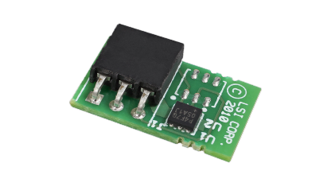

Cache
Caching is an efficient way to store and retrieve data.
You can control the lifetime of cached items
Typically used when you want to improve site performance
Reduce database calls
Accessing files on File System
Calling external services
There are several types of Cache, like:
Memory Cache, Distributed Cache, Response Cache, etc...

Slide 14

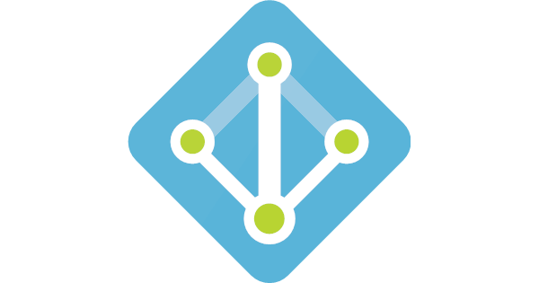
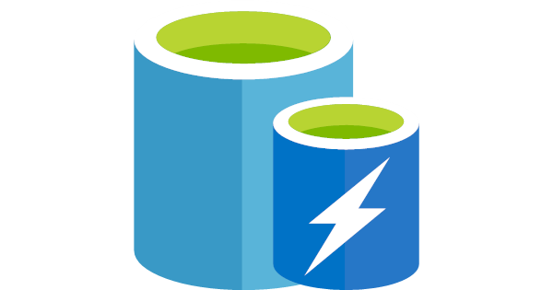
Differences between Session & Cache
Discussion Block
Example Cases
Notes:
Read the best answer on this question: https://stackoverflow.com/questions/14653065/what-is-difference-between-session-cache-and-profile-in-asp-net

Slide 15

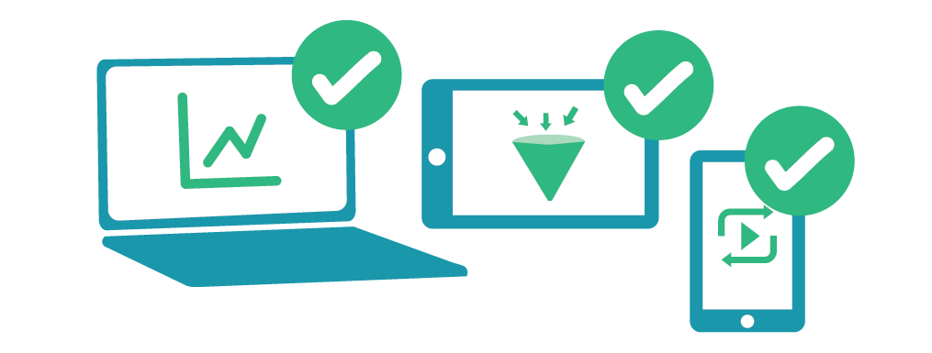

Summary
Web Sockets
SignalR
Session & Cache
Differences

Slide 16







C# MVC Frameworks – Cookbook
https://softuni.bg/courses/asp-net-mvc

Slide 17
License
This course (slides, examples, demos, videos, homework, etc.) is licensed under the "Creative Commons Attribution-NonCommercial-ShareAlike 4.0 International" license

Slide 18





Trainings @ Software University (SoftUni)
Software University – High-Quality Education, Profession and Job for Software Developers
softuni.bg
Software University Foundation
http://softuni.foundation/
Software University @ Facebook
facebook.com/SoftwareUniversity
Software University Forums
forum.softuni.bg

